Slide 1
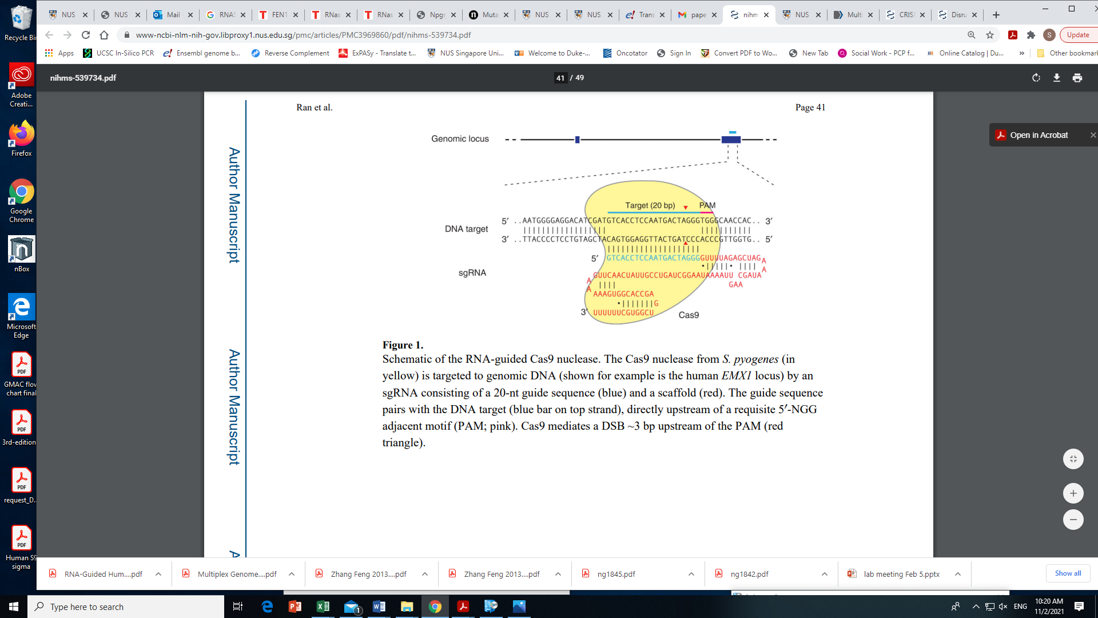
RNASEH2A, RNASEH2B, RNASEH2C and FEN1 gene knockout using CRISPR-Cas9 system
Notes:
Okazaki fragments are short sequences of DNA nucleotides (approximately 150 to 200 base pairs long in eukaryotes) which are synthesized discontinuously and later linked together by the enzyme DNA ligase to create the lagging stand during DNA replication.

Slide 2
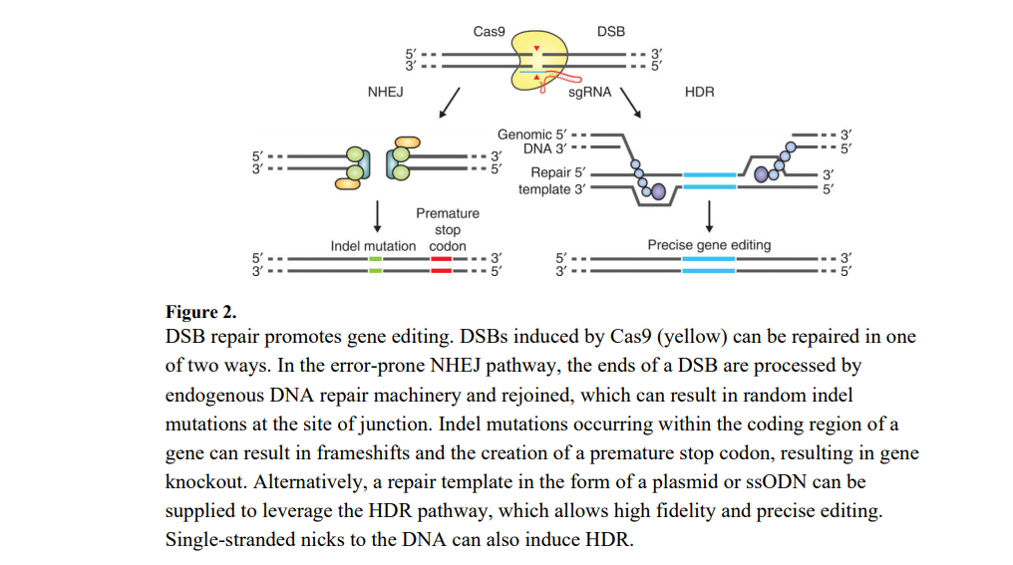

Slide 3
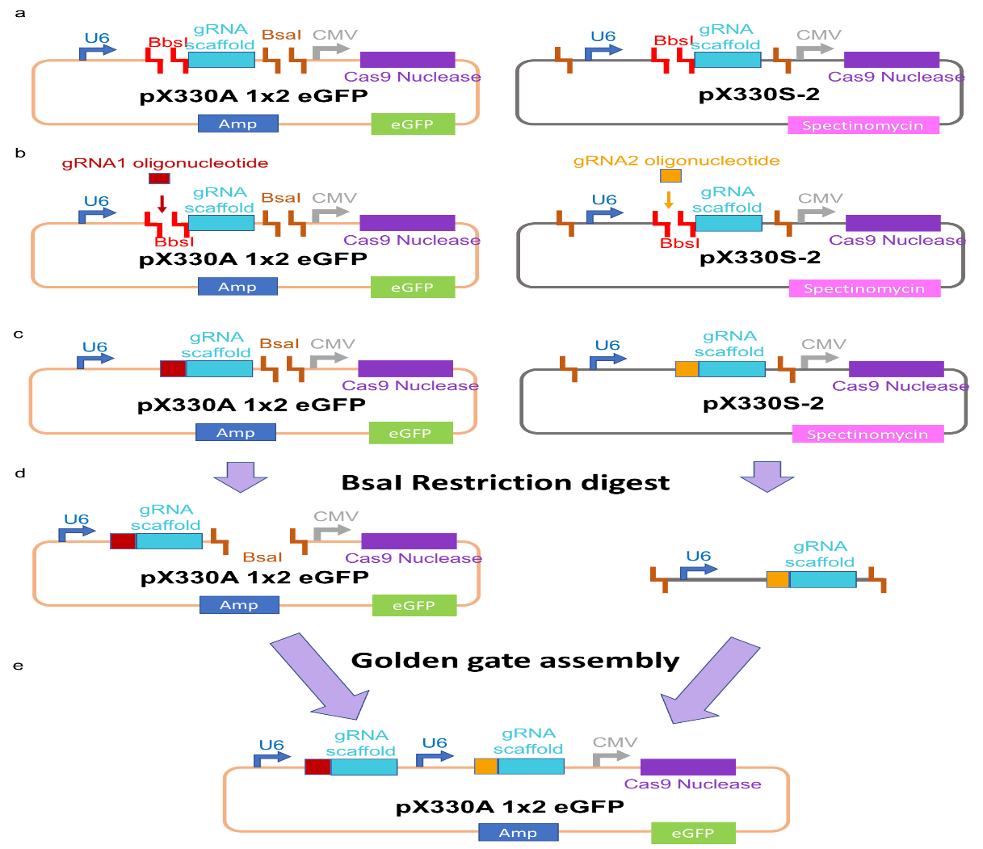
Step 1. Single gRNA cloning
Anneal sgRNA forward and reverse oligo to form oligo duplex
Ligate the oligo duplex to 100ng of px330A-GFP or px330-S2 (BbsI)
3. Transform the DNA into competent bacteria (STBL3 and DH5α) and sequencing the clone

Slide 4
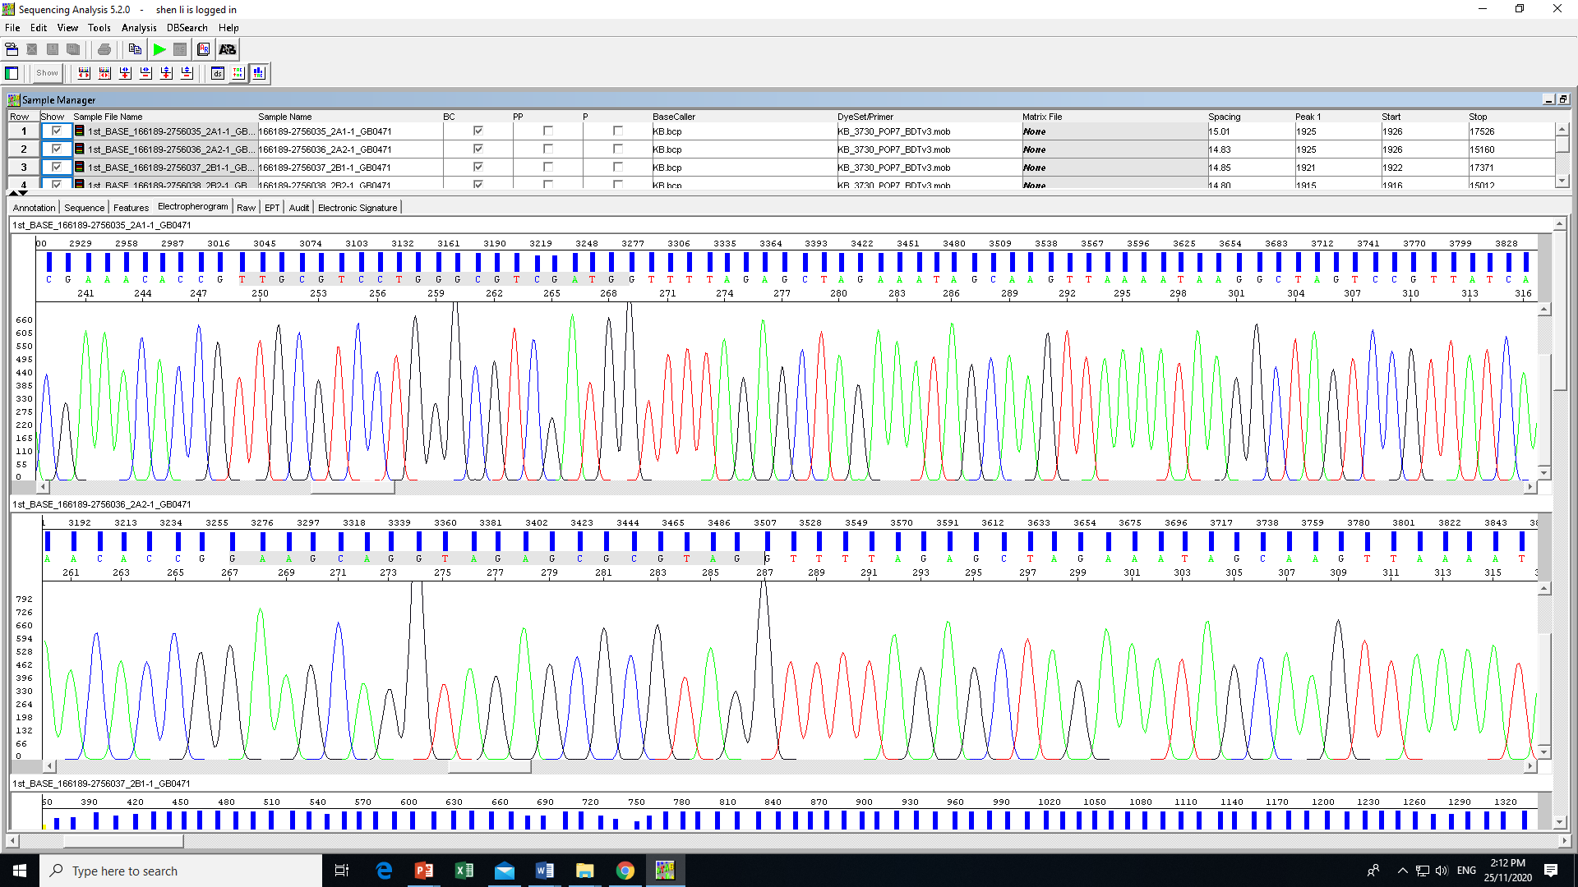
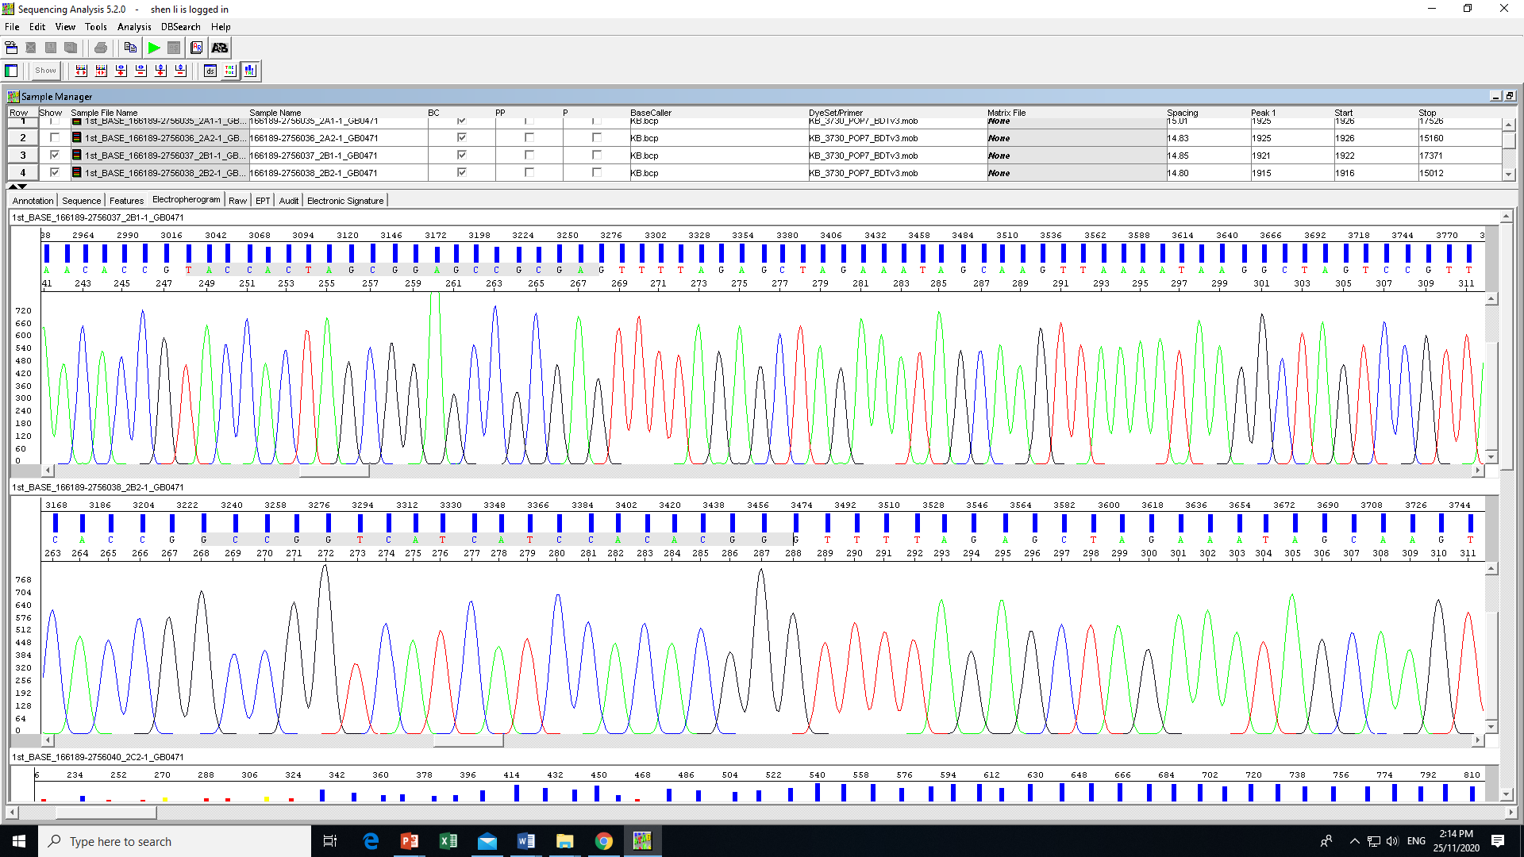
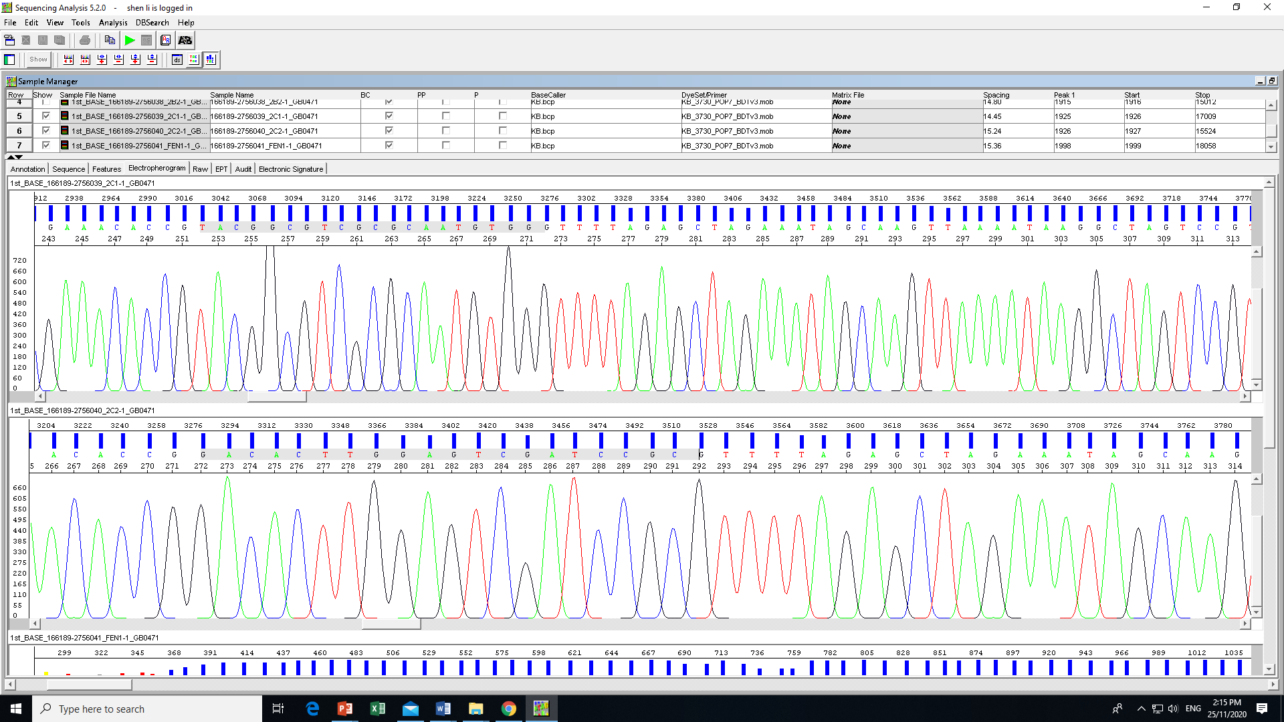
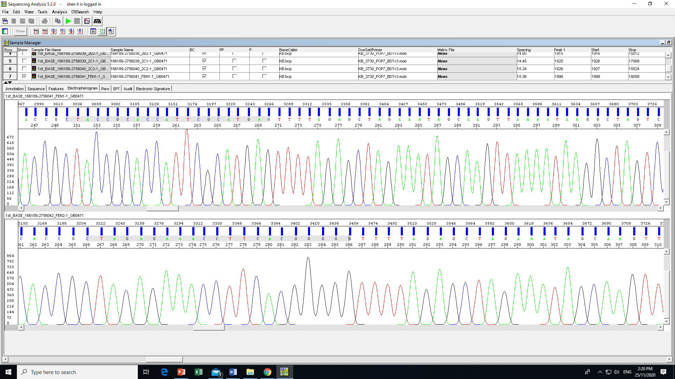
RNASEH2A
RNASEH2B
RNASEH2C
FEN1

Slide 5
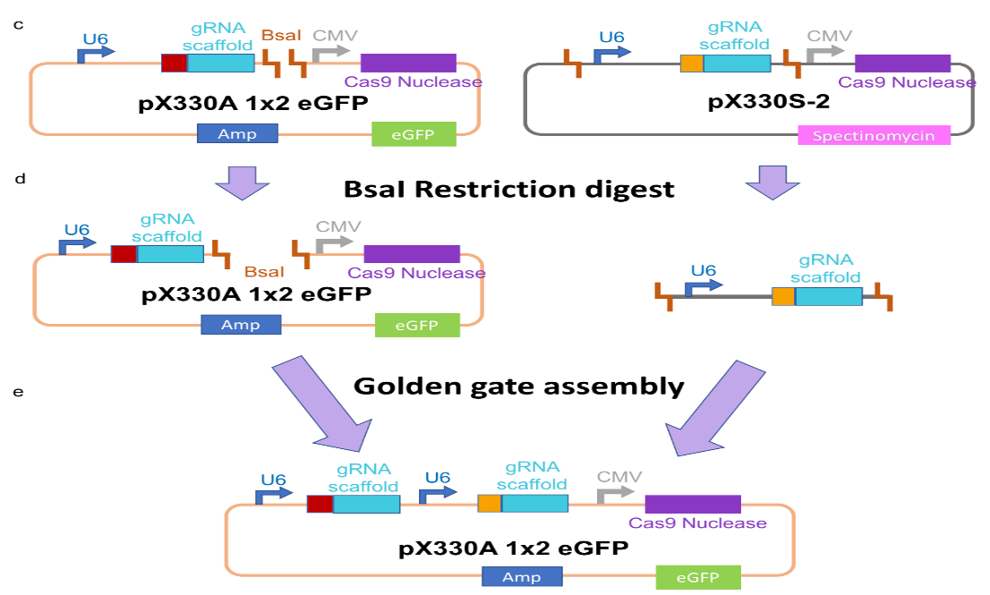
Step 2. Double sgRNA cloning
Use pX330A-Cas9-2A-GFP and pX330S vector with sgRNA from step 1
1. Ligate 150ng of each module vector (pX330A) + 150ng pX330S2 vector (BsaI) by the golden gate assembly which is a method for assembling multiple DNA fragments, relying on the activity of Type IIS endonucleases that cleave outside of non-palindromic recognition sites.
2. Transform the DNA into competent bacteria (STBL3) and sequencing the clone.
3. For correct clone, do endo-free midi-prep for downstream experiment.

Slide 6
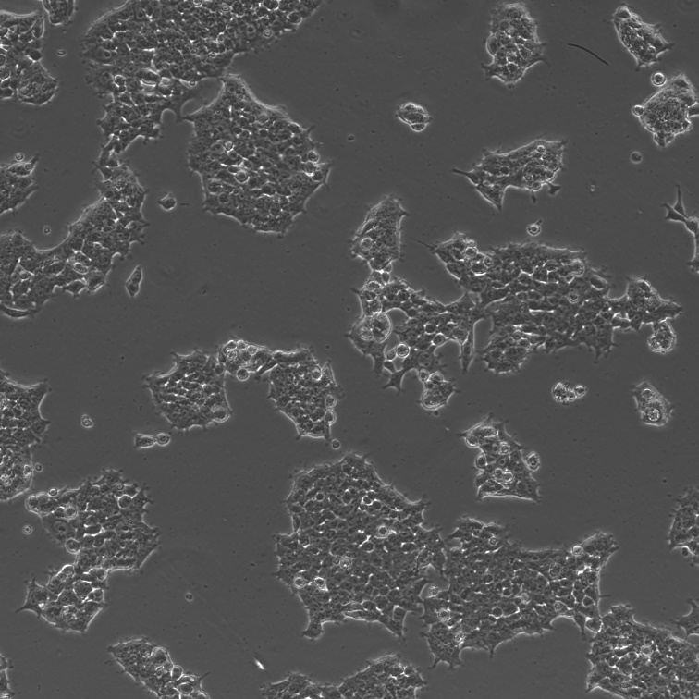
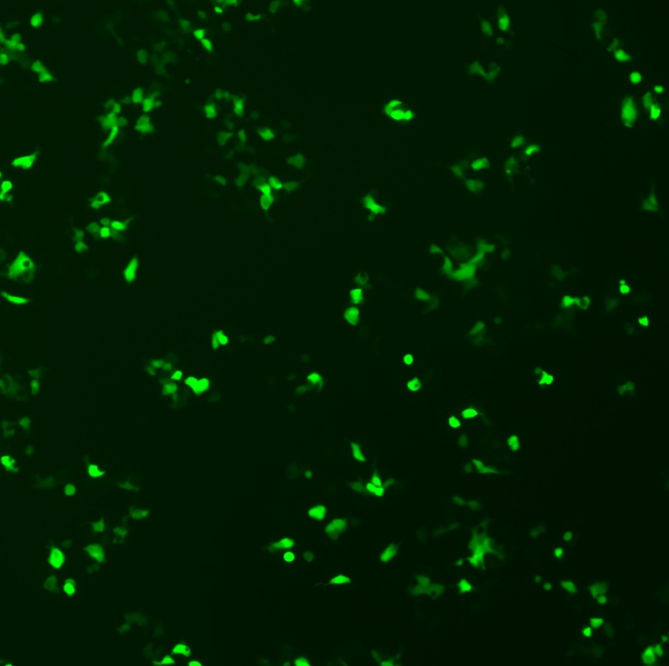
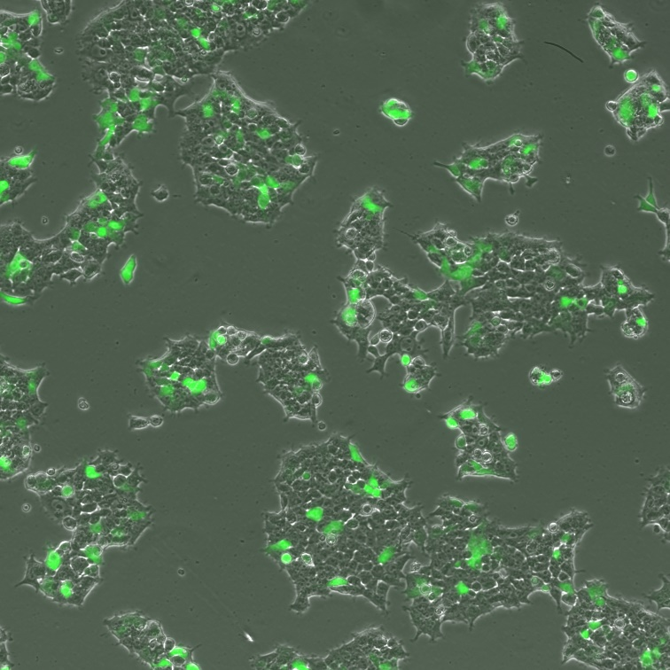
Hek293T

Slide 7
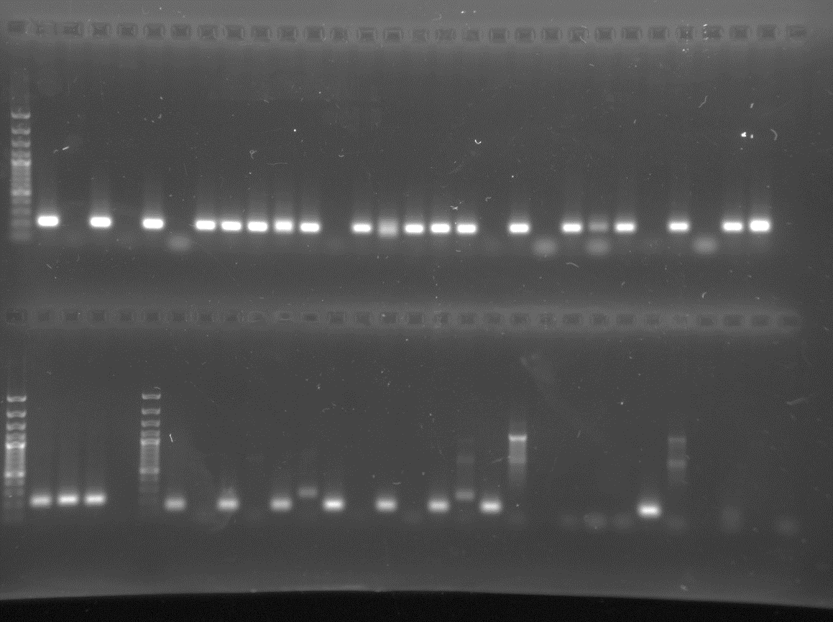
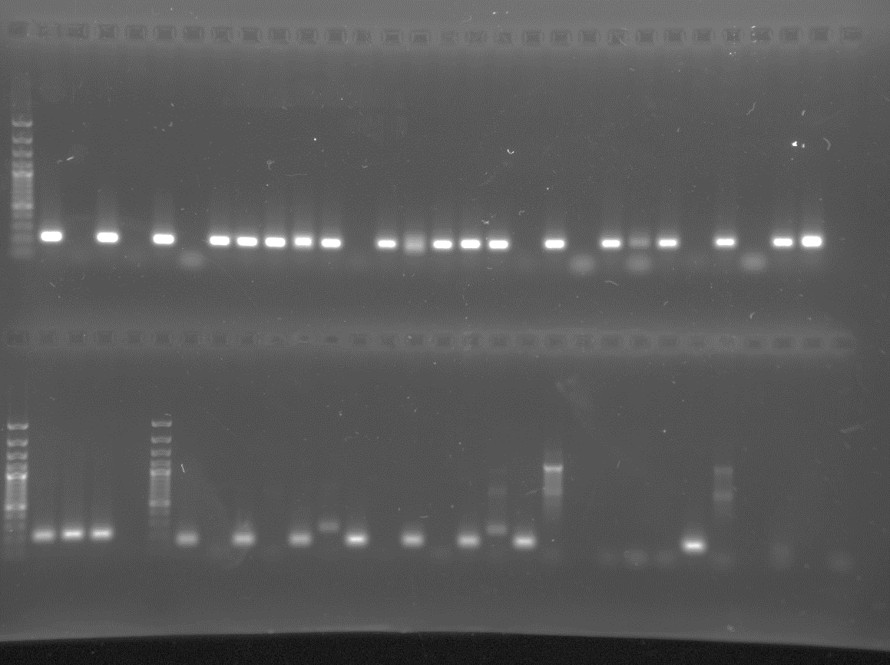
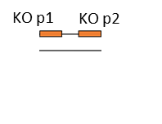
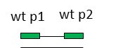
Hek293T RNASEH2A
Original Cell lysis PCR
CL 1
CL 2
CL 3
CL 4
CL 5
CL 6
CL 7
CL 8
CL 9
CL 10
CL 11
CL12
CL 13
CL 14
CL 15
CL 16
500bp
Wt KO
Wt KO
Wt KO
Wt KO
Wt KO
Wt KO
Wt KO
Wt KO
Wt KO
Wt KO
Wt KO
Wt KO
Wt KO
Wt KO
500bp
Wt KO
Wt KO
200bp
200bp
100bp
100bp
Potential Heterozygous Knockout – 7 clones
6719
KO p1
wt p1
wt p2
KO p2
5’
3’
3’
5’
KO product 185
WT product 213

Slide 8
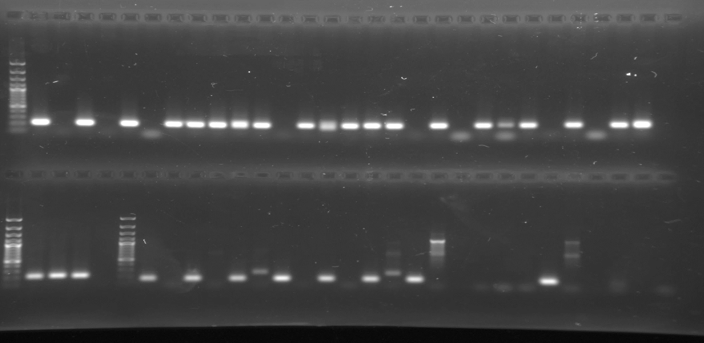
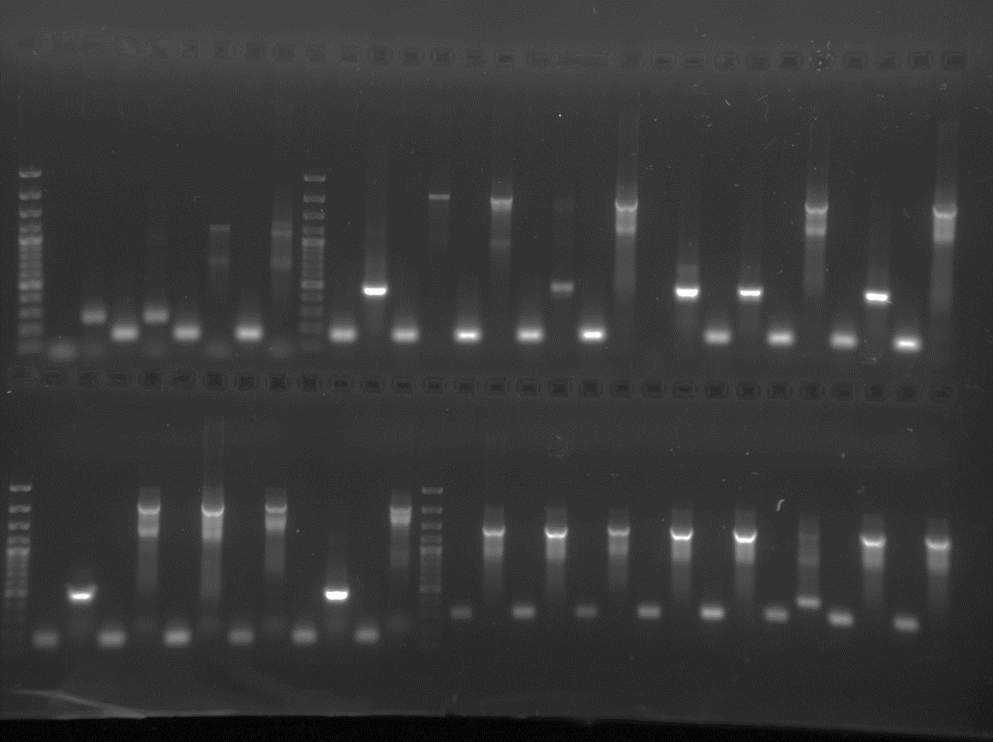
Hek293T RNASEH2B
Original Cell lysis PCR
CL 1
CL 2
CL 3
CL 4
CL 5
CL 6
CL 7
CL 8
CL 9
CL 10
CL 11
CL12
CL 13
CL 14
CL 15
CL 16
500bp
Wt KO
Wt KO
Wt KO
Wt KO
Wt KO
Wt KO
Wt KO
Wt KO
Wt KO
Wt KO
Wt KO
Wt KO
500bp
Wt KO
Wt KO
Wt KO
Wt KO
200bp
200bp
Potential Heterozygous Knockout – 3 clones
Potential homozygous Knockout- 1 clone
906
wt p2
KO p1
wt p1
KO p2
3’
5’
5’
3’
KO product 223
WT product 165

Slide 9
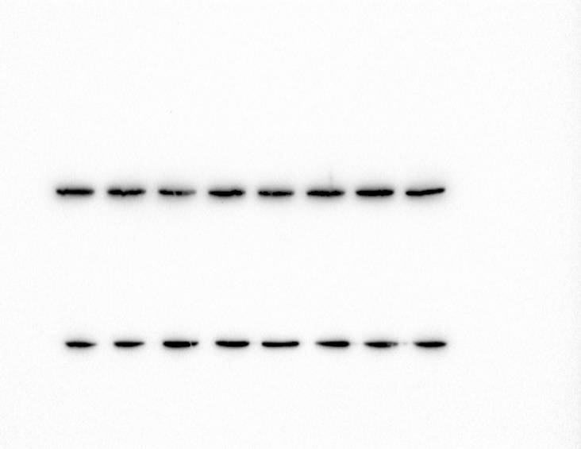
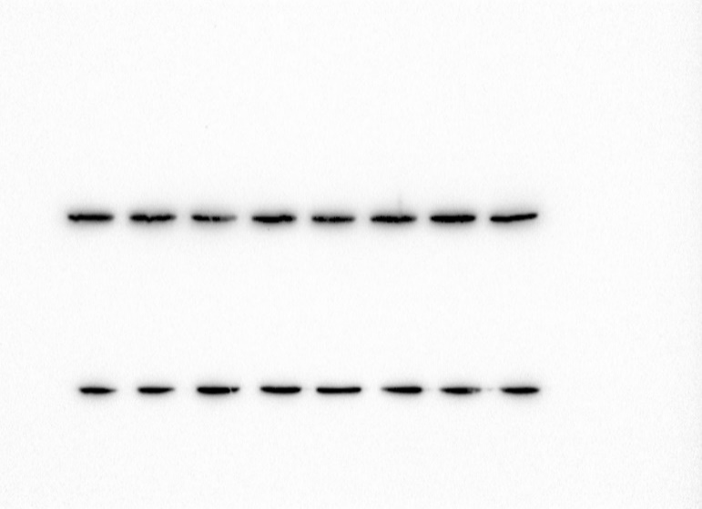
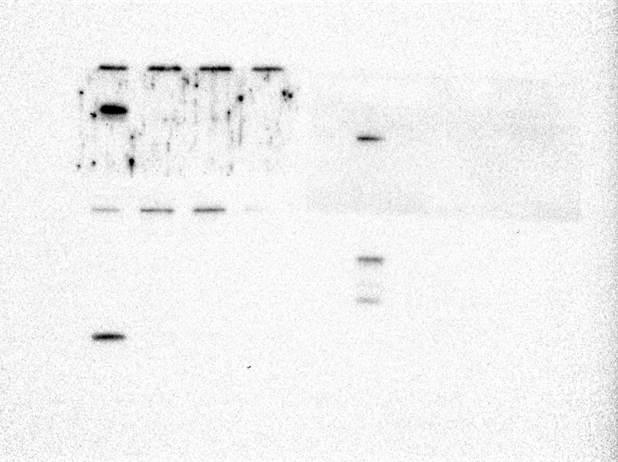

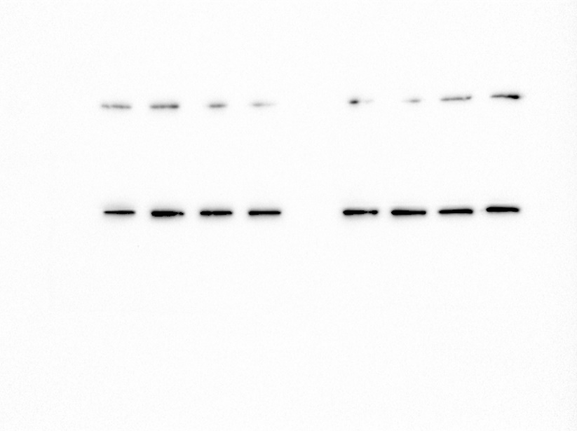
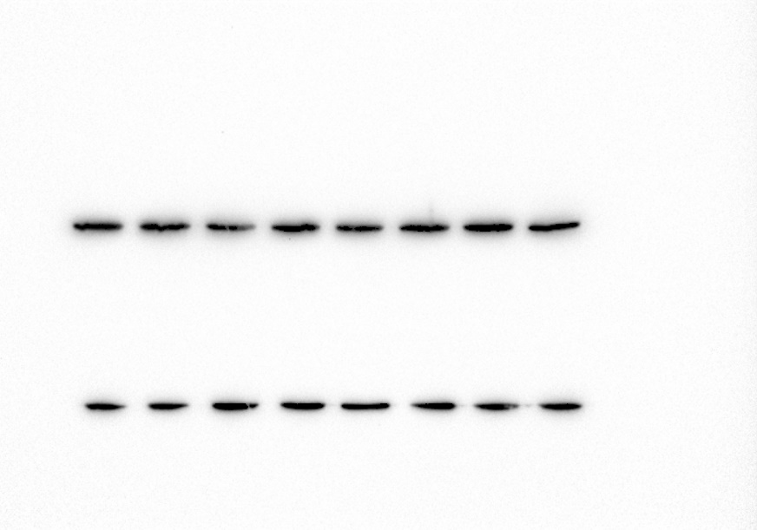
293T wt
Sample 1
Sample 2
Sample 3
293T wt
Sample 1
Sample 2
Sample 3
Hela wt
Sample 1
Sample 2
Sample 3
Hela wt
Sample 1
Sample 2
Sample 3
RNASE H2A
RNASE H2B
RNASE H2A
RNASE H2B
Actin
Actin
Actin
Actin
293T wt
Sample 1
Sample 2
Sample 3
293T wt
Sample 1
Sample 2
Sample 3
Sample 1
Sample 2
Sample 3
Hela wt
Sample 1
Sample 2
Sample 3
Hela wt
RNASE H2C
FEN1
RNASE H2C
FEN1
Actin
Actin
Actin
Actin

